Slide 1
Machine Learning Skyrmions
Vinit Kumar Singh (IIT Kharagpur)

Slide 2
AGENDA
Machine Learning and Physics
Basics of Machine Learning
Supervised Learning
Neural Networks
Unsupervised Learning
Convolutional Neural Network
Machine Learning Skyrmion

Slide 3
Physics and machine learning
The LHC at CERN. Machine learning algorithms are used to check for anomalous data and to present a summarized report for humans to work with.
Processing of satellite data in atmospheric physics as well as handle weather forecasts and predictions.
Astrophysicists routinely use machine learning techniques to classify and organize data generated for Telescopes.
condensed matter physicists use Machine Learning to predict the behavior of systems of Manybody.

Slide 4
Why Machine Learning?
Tackling with Huge data.
Ability to mimic humans and automate certain monotonous task
Classify, Predict, Detect and Organize.
Cognitive Skills
Visualize high dimensional data.

Slide 5
What is Machine Learning?
A subset of Artificial Intelligence (AI). AI is defined as the study of "intelligent agents": any device that perceives its environment and takes actions that maximize its chance of successfully achieving its goals.
The ability of computers to "learn" with data, without being explicitly programmed.
A computer program is said to learn from experience E with respect to some class of tasks T and performance measure P, if its performance at tasks in T, as measured by P, improves with experience E. ~Arthur Samuel
Notes:
Example of game of Checkers.
Learning from experiences.

Slide 6
Types Machine Learning
Supervised Learning
Unsupervised Learning
Semi-unsupervised learning
Reinforcement Learning

Slide 7
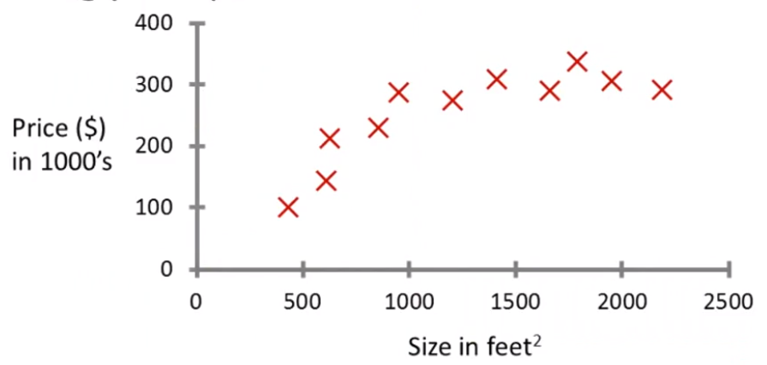
Basic Terminology
Feature
Label
Training
Data Set : Training, Validation and Test.
Feature Extraction.

Slide 8
Supervised Learning
The correct labels of training data is known.
House price prediction
Spam Filters
Image classification
Stock prices
Weather prediction

Slide 9
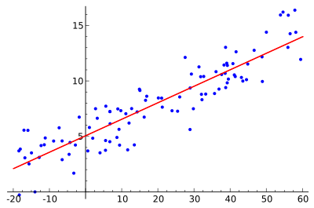
Linear Regression
Fitting a line which passes through the center of these point.
Y=M*X+C
Try to minimize sum of the squared vertical distance between the line and every point.
Σ(Y_{k}-Y)² where Y=M*X_{k}+C

Slide 10
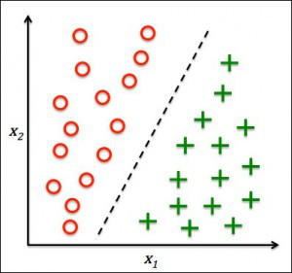
logistic regression
Deals with classification problems.
Determines boundary that classifies labelled clusters.
Example:
Spam Filters
Image classification
Notes:
How supervised learning is performed

Slide 11
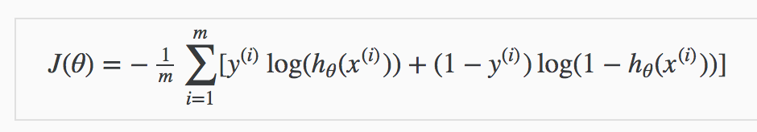
Cost Function
Linear Regression
Σ(Y_{k}-Y)² where Y=M*X_{k}+C
General Machine Learning algorithms for prediction
Σ(Y_{predicted}-Y_{actual})²
Logistic Regression

Slide 12

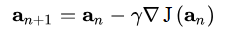
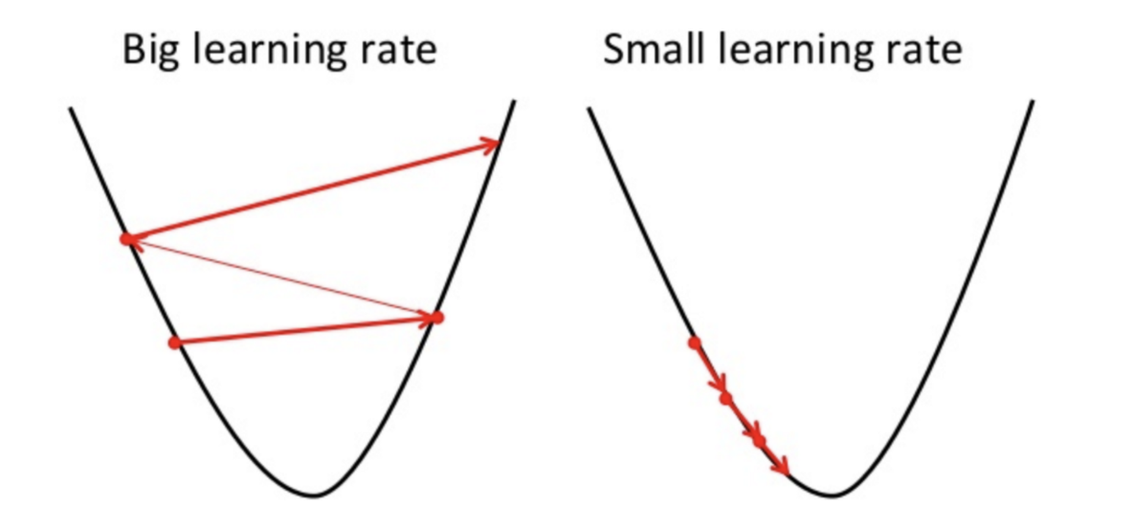
Gradient Descent
Gradient descent is a first-order iterative optimization algorithm for finding the minimum of a function

Slide 13
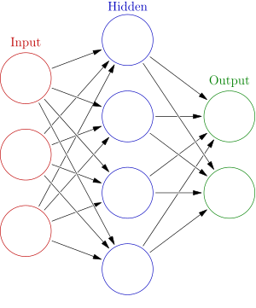
Neural networks

Slide 14
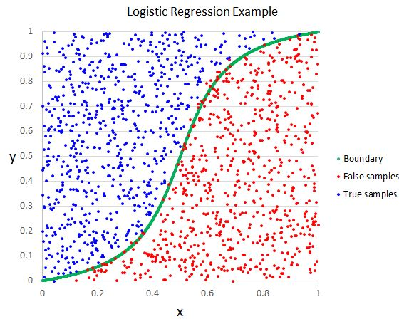
Why Neural Network

Slide 15
Motivation behind neural network
Brain – processes data through interconnected neurons
Learns from experiences
Though brain has more complicated architecture.

Slide 16
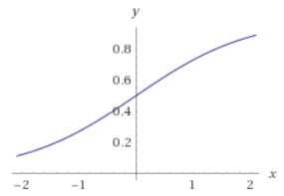
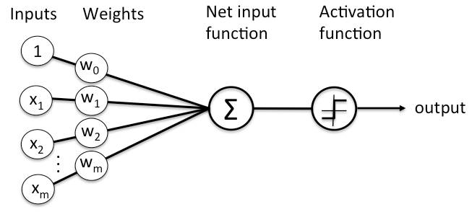
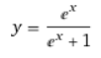
perceptron
Machine’s equivalent of neuron
Y=A(WX^{T})

Slide 17
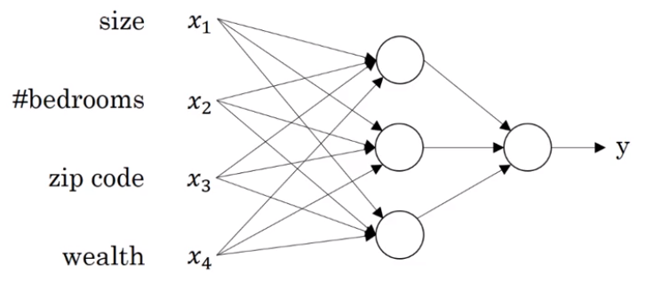
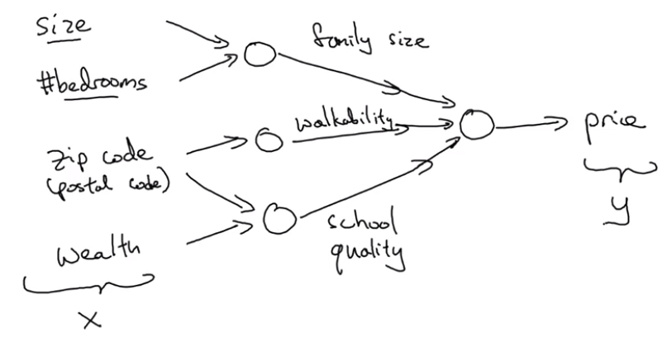
neural network
Y=A(WX^{T})
Notes:
Feature Extraction

Slide 18
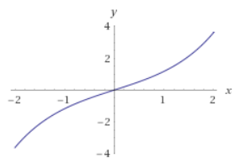
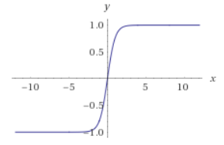
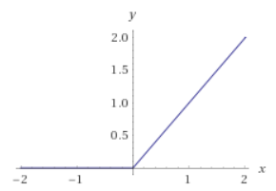
Activation function
Adds the non-linearity to the neural network.
Most popular being the ReLu function.
Makes Neural Networks learn any non-linear function.
Y=sinh(X)
Y=tanh(X)
Y=ReLU(X)
Y=(X+|X|)/2

Slide 19
Unsupervised learning
Unsupervised learning is a type of machine learning algorithm used to draw inferences from datasets consisting of input data without labeled responses.
Clustering
Principal Component Analysis
Autoencoder
Anomaly Detection
Generative Adversarial Network (GAN)

Slide 20
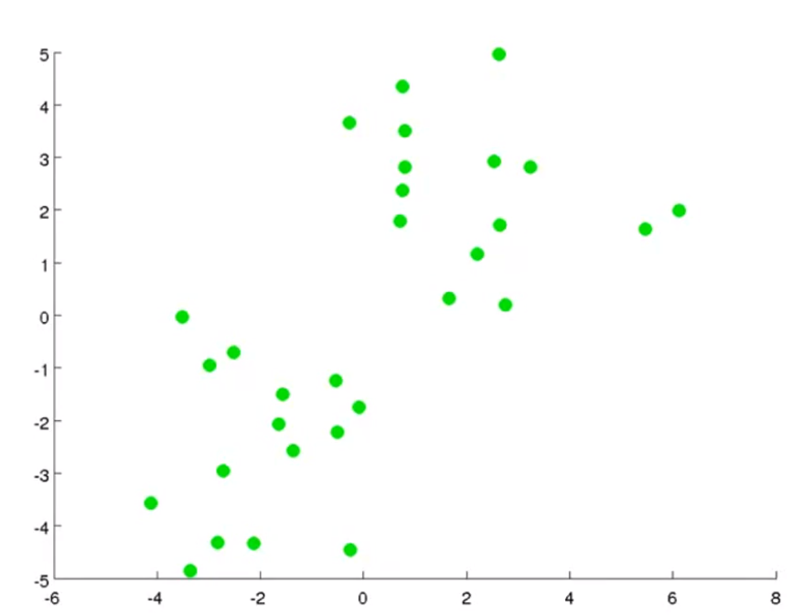
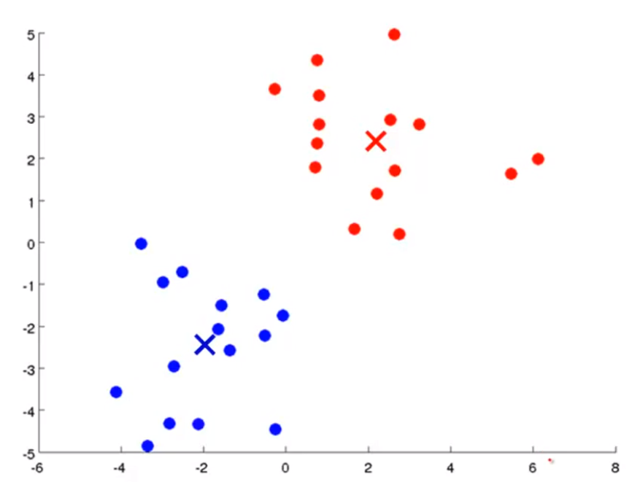
Clustering

Slide 21
Clustering Examples
Astronomical Data Analysis
Organize computer clusters
Social Network Analysis
Market Segmentation
Predicting heredity by analyzing their genetic code.

Slide 22
K-Means Clustering
Algorithm
Cost Function

Slide 23
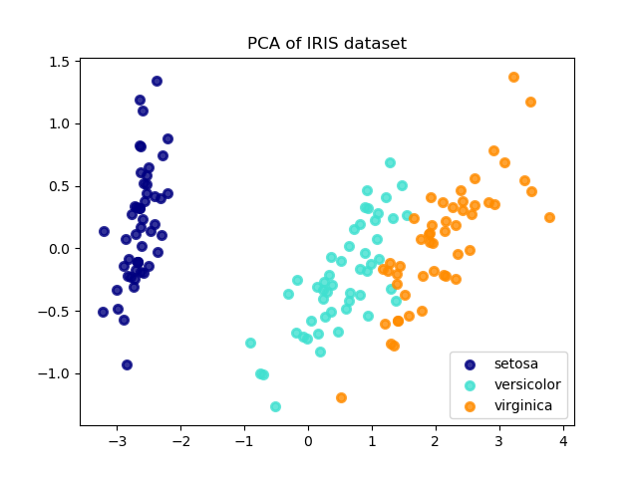
Principal component analysis
Dimensionality Reduction
Visualizing high-dimensional data in low-dimension
Removing Redundant Features
Used prior to clustering
Example – Iris, GDP of a country, House-Pricing

Slide 24
Principal component analysis
“Principal component analysis (PCA) is a statistical procedure that uses an orthogonal transformation to convert a set of observations of possibly correlated variables into a set of values of linearly uncorrelated variables called principal components.”
Preprocessing – Normalization of data X_{i} = (X_{i} - μ) / S
Covariance Matrix Σ = X*X^{T}
Leading Eigen vectors
Projection of X over the Leading Eigen Vector.

Slide 25
Deep learning

Slide 26
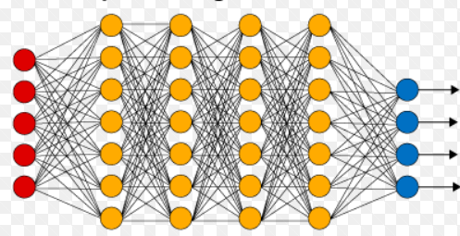
Deep learning
Neural Network Layers:
Input, Hidden and Output
Learns intricate Features
Most Realistic Problems are solved using Deep Learning.
Computer Vision
Face Recognition
Speech Recognition

Slide 27
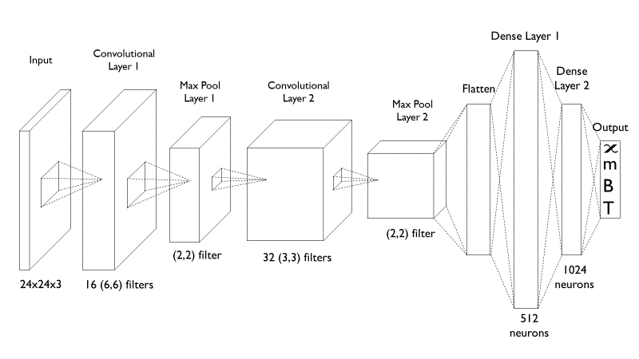
CNN (convolutional neural network)
Notes:
Face Recognition
Image Processing
Video Processing – Self-driving Cars

Slide 28
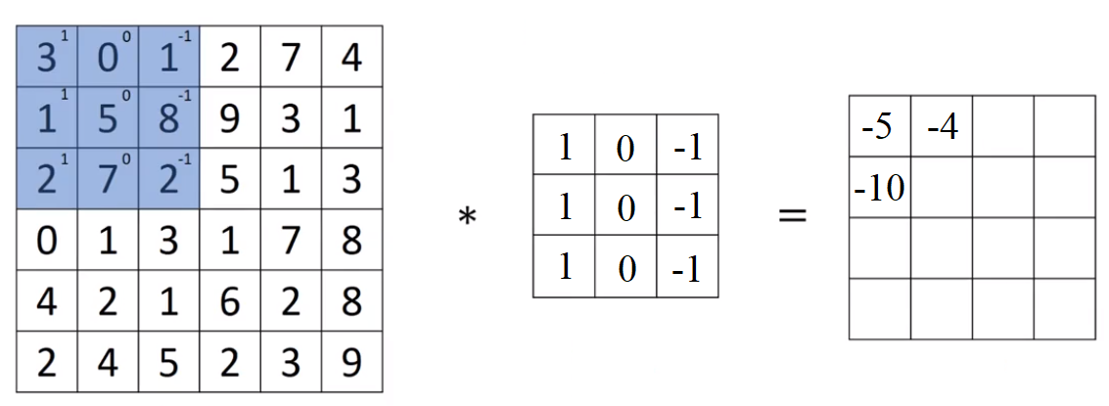
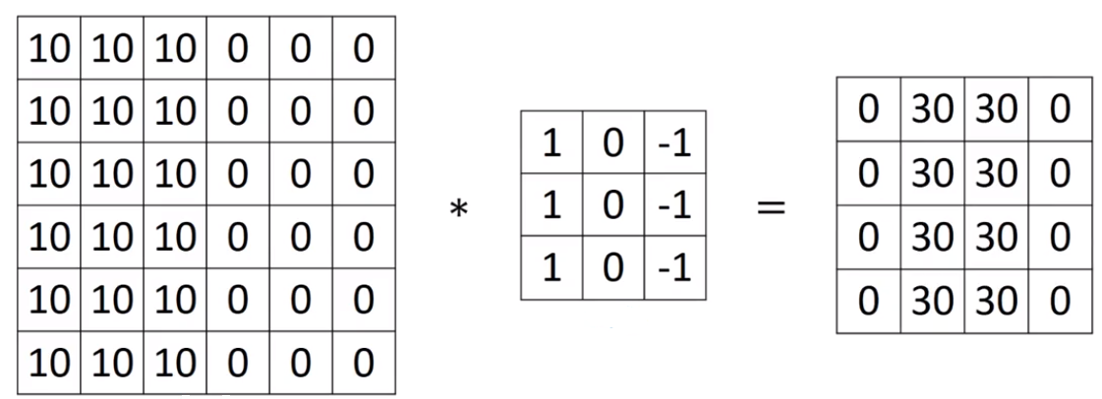
CNN Layers
Convolutional Layer
Convolution Operation
Image Filters
Edge Detection
Max Pooling Layer
Learning Local Features

Slide 29
Machine learning And Condensed Matter Physics

Slide 30
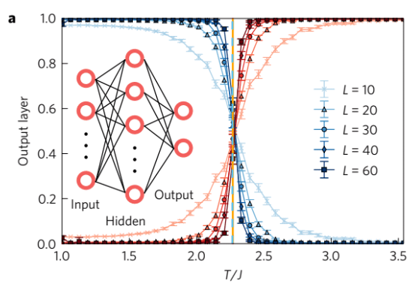
Ising Model
Classify Ordered and Disordered Phases
Predict Critical Temperature
Predict Magnetization
Shallow Neural Network works fine
Second Order Phase Transition
“Machine learning phases of matter”
Juan Carrasquilla and Roger G. Melko

Slide 31
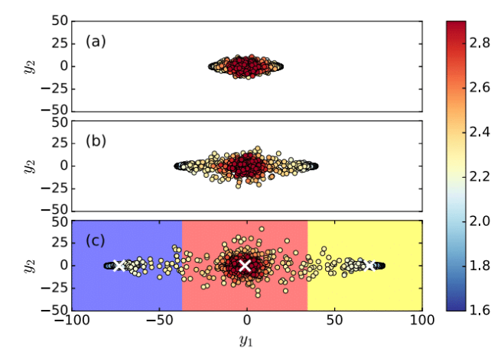
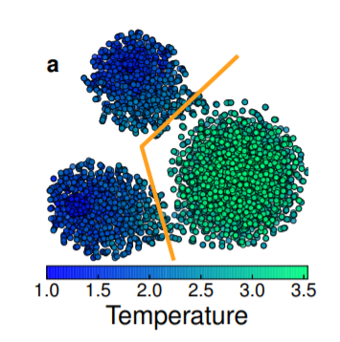
Ising Model - PCA

Slide 32
Other Attempts
Models:
XY
Potts
Blume-Capel
BSI
ML Method
PCA
Autoencoder

Slide 33
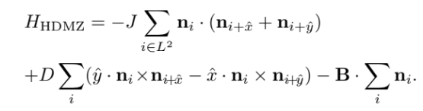
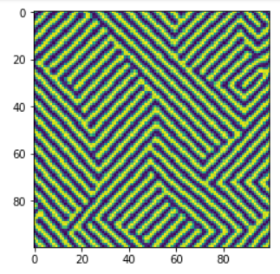
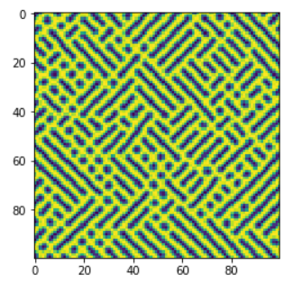
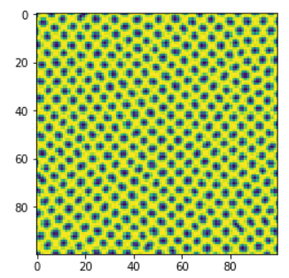
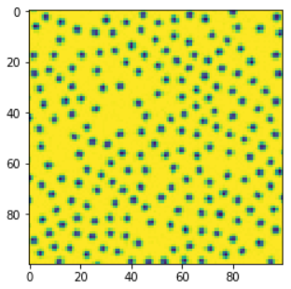
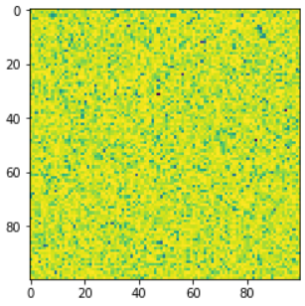
Heisenberg Model
Interesting - Spiral, Skyrmion, and Ferromagnet
First Order Phase transition
Continuous spin model
Order Parameters are complex function

Slide 34
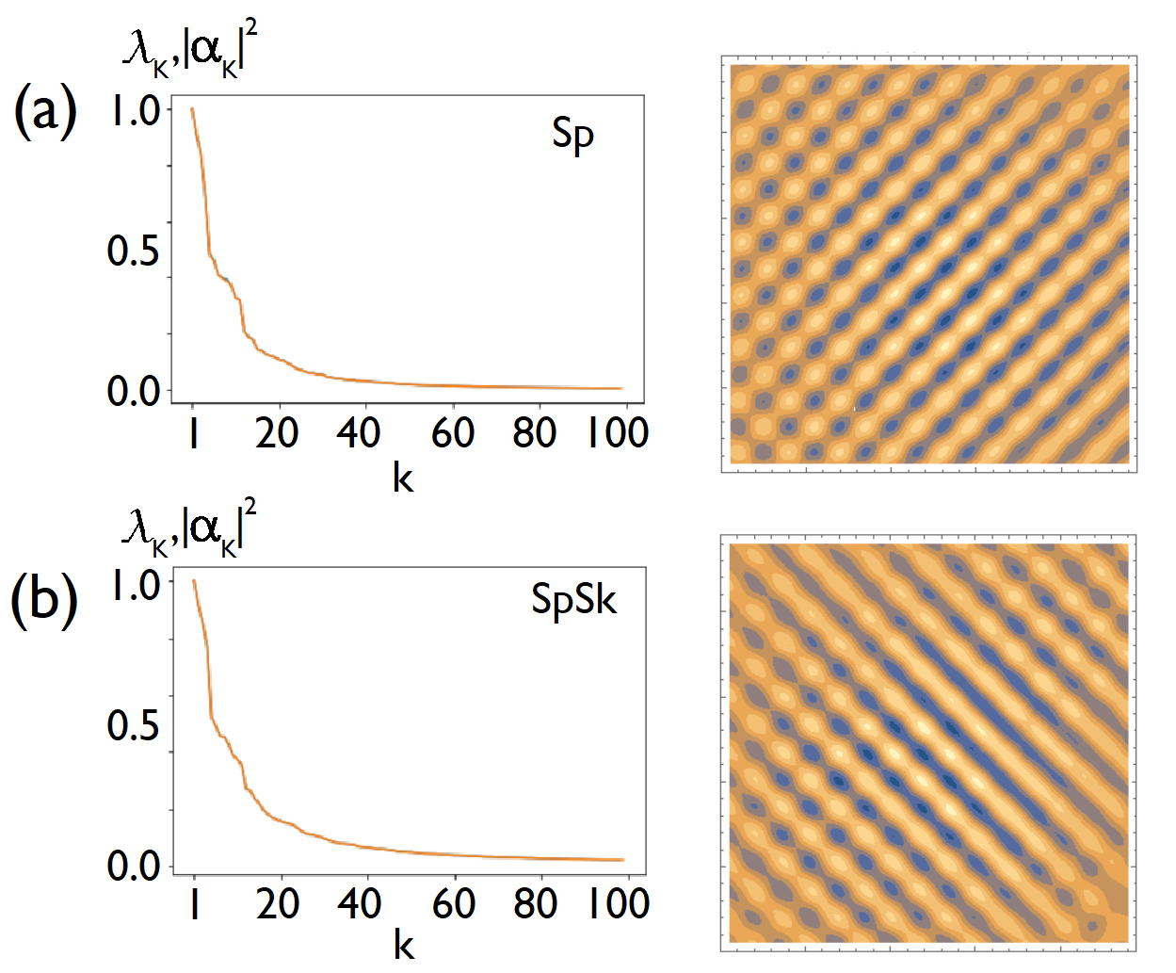
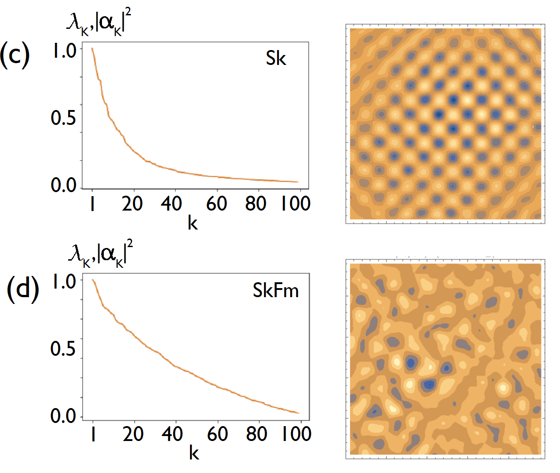
Principal Component Analysis

Slide 35
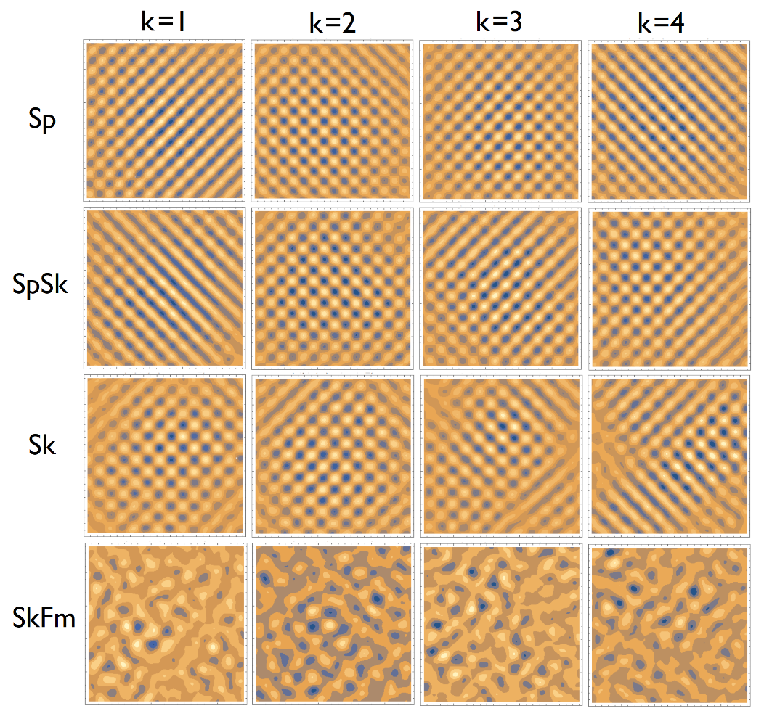
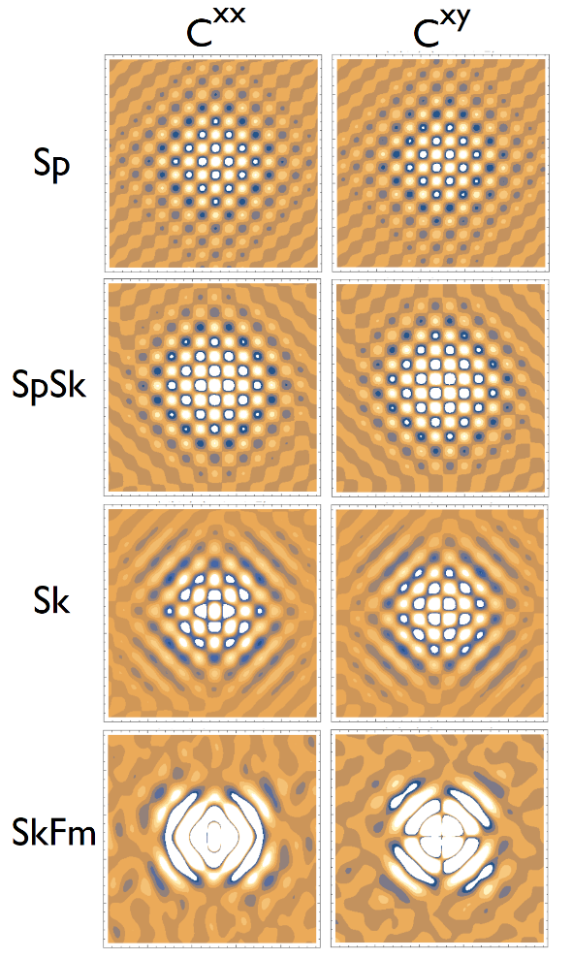
Principal Component Analysis

Slide 36
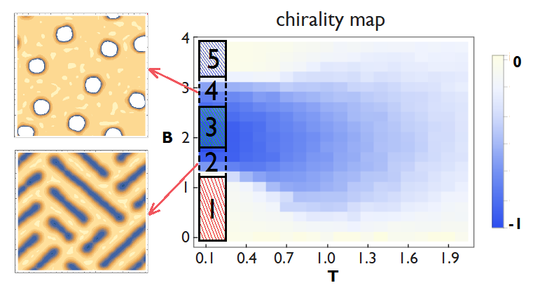
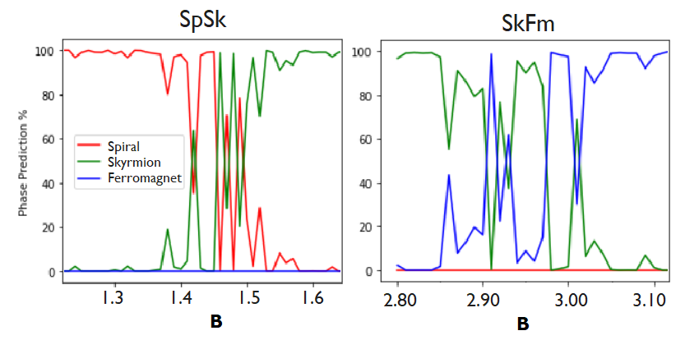
Phase Prediction

Slide 37
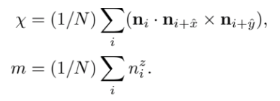
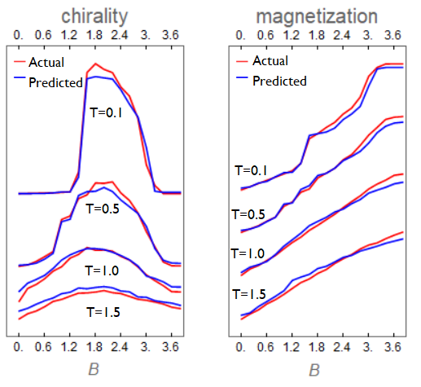
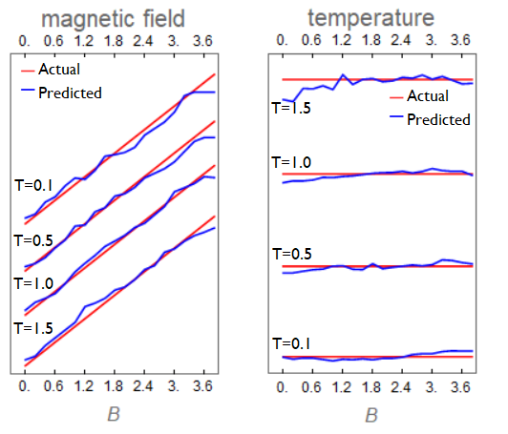
Feature Prediction

Slide 38
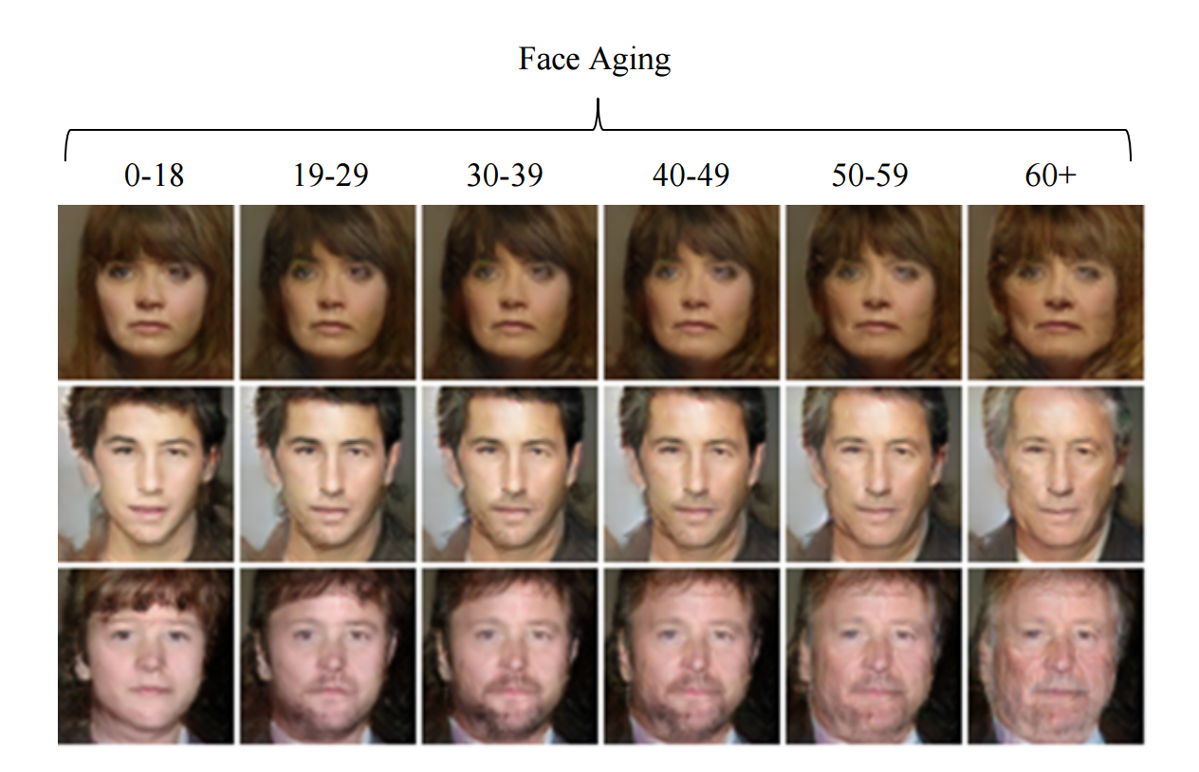
Gan (generative adversarial network)
Add your first bullet point here
Add your second bullet point here
Add your third bullet point here

Slide 39
CNN Architecture

Slide 40

Reinforcement learning
Reinforcement learning is an area of machine learning inspired by behaviourist psychology, concerned with how software agents ought to take actions in an environment so as to maximize some notion of cumulative reward.

Slide 41

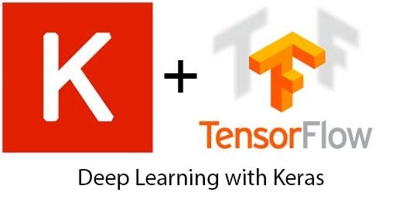
acknowledgement
Machine Learning by Andrew Ng.
Deep Learning Specialization by Andrew Ng.

Slide 42


Parallel Computing
Rise of Machine Learning
CPU vs GPU
Matrix Operations
CUDA

